Slide 1
Lost in communication
Adapted by Dr. Aparajita Jaiswal, Dr. Tatjana Babic-Williams, and Kelsey Patton, CILMAR, from:
ZHAW Gesundheit. (2022, February 2). Lost in communication: an intercultural meeting [Video]. YouTube. https://www.youtube.com/watch?v=JfATJkWyd7g&t=17s
Hammer, M. (2005). Intercultural Conflict Style Inventory. ICS Inventory, LLC. https://icsinventory.com/

Slide 2
Today, we will learn to:
LOST IN COMMUNICATION
Identify our own and others’ personal communication styles within teams.
Practice our ability to shift our communication style appropriately when engaging with others in a team setting.
Develop effective strategies to build a more inclusive team environment where all voices are welcomed and heard.

Slide 3
watch

Slide 4
LOST IN COMMUNICATION
ZHAW Gesundheit. (2022, February 2). Lost in communication: an intercultural meeting [Video]. YouTube. https://www.youtube.com/watch?v=JfATJkWyd7g&t=17s

Slide 5
Discuss and share

Slide 6
LOST IN COMMUNICATION
LOST IN COMMUNICATION
Small group discussion
What stuck out to you from the video?
How did it feel to watch different ways of participating in a team meeting?
Which character did you resonate/relate with most?
How do you typically share your ideas? Are you first to share, last to share, etc.?
What factors influence your willingness to share (history of the group, power dynamics, group size, your culture, your family norms, etc.)?

Slide 7
LOST IN COMMUNICATION
LOST IN COMMUNICATION
Small group discussion
What insight did hearing the inner thoughts of each character provide?
What team meeting habits/behaviors in others do you find challenging?
What team meeting habits/behaviors in yourself do you think others find challenging?
Notes:
.

Slide 8
LOST IN COMMUNICATION
LOST IN COMMUNICATION
Small group discussion
Imagine the internal dialogue of someone with a challenging habit/behavior in a team meeting. What do you think they might be thinking/feeling?
What does your internal dialogue typically sound like in a challenging team meeting? What are you thinking and feeling in these moments?
Notes:
.

Slide 9
debrief

Slide 10
LOST IN COMMUNICATION
LOST IN COMMUNICATION
Debrief
What are your biggest takeaways from the video and your small group discussion?
Reflecting upon past team meetings in which you participated, how does this video relate to team dynamics you have experienced?
Based on your small group discussion, what factors and/or aspects of your culture influence what, how, and when you share your thoughts in a team meeting?

Slide 11
Learn:
WHAT MATTERS IN TEAM COMMUNICATION?

Slide 12
LOST IN COMMUNICATION
LOST IN COMMUNICATION
Directness
Emotional restraint
Emotional expressiveness
Indirectness
Hammer, M. (2005). Intercultural Conflict Style Inventory. ICS Inventory, LLC. Retrieved from https://icsinventory.com/
Notes:
Facilitator notes: Briefly introduce and describe the Intercultural Conflict Styles Inventory (Hammer, 2005). Ask participants to place themselves (not literally, just in their minds) in one of the quadrants.

Slide 13
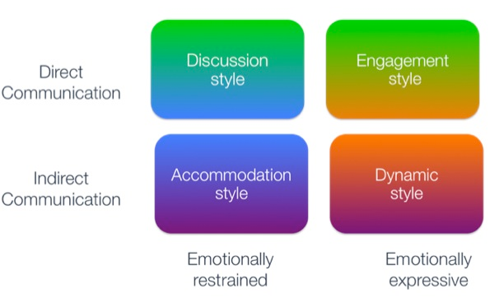
LOST IN COMMUNICATION
LOST IN COMMUNICATION
Hammer, M. (2005). Intercultural Conflict Style Inventory. ICS Inventory, LLC. Retrieved from https://icsinventory.com/
Notes:
Facilitator notes: Briefly introduce and describe the Intercultural Conflict Styles Inventory (Hammer, 2005). Ask participants to place themselves (not literally, just in their minds) in one of the quadrants.

Slide 14
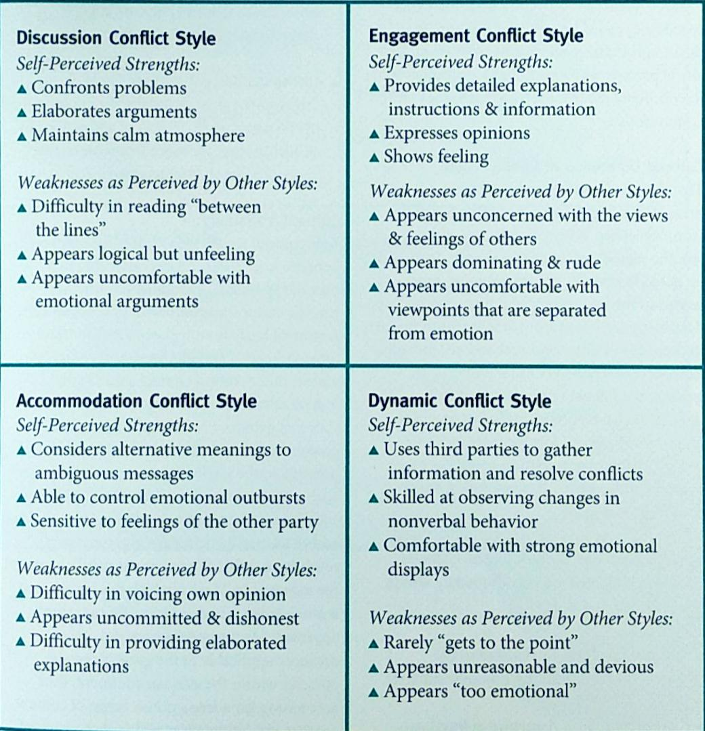
LOST IN COMMUNICATION
LOST IN COMMUNICATION
Hammer, M. (2005). Intercultural Conflict Style Inventory. ICS Inventory, LLC. Retrieved from https://icsinventory.com/
Notes:
Facilitator notes: Briefly introduce and describe the Intercultural Conflict Styles Inventory (Hammer, 2005). Ask participants to place themselves (not literally, just in their minds) in one of the quadrants.

Slide 15
LOST IN COMMUNICATION
LOST IN COMMUNICATION
Direct vs. Indirect
Communication Styles

Slide 16
LOST IN COMMUNICATION
LOST IN COMMUNICATION
Direct Communication
Direct communication is common in low-context cultures. The communication style is considered direct as the communicators tend to speak what they think (Joyce, 2012).
The overall goal of communication is “getting or giving information” (Peace Corps, 1997, p. 78).
For example:
That’s a bad idea. That won’t work.
I don’t agree with you. Here’s why.
We have problems with your idea.
Joyce, C. (2012). The impact of direct and indirect communication. Journal of the International Ombudsman Association.
Peace Corps. (1997). Culture matters: The peace corps cross-cultural workbook. Washington, D.C.: Peace Corps Information Collection And Exchange.

Slide 17
LOST IN COMMUNICATION
LOST IN COMMUNICATION
Indirect Communication
Indirect communication is commonly practiced in high-context cultures. The communicators convey their messages verbally along with some nonverbal behaviors such as pauses, tone, eye movements, etc. (Joyce, 2012; Ting-Toomey & Dorjee, 1999).
For example:
Are there any other ideas?
May I make a small suggestion?
Your idea might work.
Joyce, C. (2012). The impact of direct and indirect communication. Journal of the International Ombudsman Association.
Ting-Toomey, S., & Dorjee, T. (1999). Communicating across cultures. New York: The Guilford Press.

Slide 18
LOST IN COMMUNICATION
LOST IN COMMUNICATION
Pacing

Slide 19
“Turn-Taking”
LOST IN COMMUNICATION
LOST IN COMMUNICATION
Detached
Fast-paced
“Listen for the period”
Person A
Person B
Person A
Person B
Time

Slide 20
“Pausing”
LOST IN COMMUNICATION
LOST IN COMMUNICATION
Reflective
Slower-paced
Need complete information before considering a reply
Silence
Person A
Person B
Person A
Person B
Time
Notes:
OK with silence
A “pauser” would potentially consider a “turn-taker” rude.
A “pauser” might never be heard.
Other styles might think that a pauser “doesn’t have an answer”

Slide 21
“Overlapping”
LOST IN COMMUNICATION
LOST IN COMMUNICATION
Attached
Faster-paced
Do not wait for the period
Person A
Person A
Person A
Person B
Person B
Person B
Time
Notes:
Both speakers jump into each others’ speaking time - such that both are talking simultaneously.
Two types:
Interruptive
Overlapping
While both are generally called overlapping, the difference lies in the content:
An interrupter-overlapper will change the subject, become the expert, or otherwise steer the conversation away from the direction of the other person.
A pure-overlapper will agree, support what you are saying (with additional information), ask for more information, but not change the subject/course of the conversation.

Slide 22
LOST IN COMMUNICATION
LOST IN COMMUNICATION
What other factors/aspects might inform how we show up in group dynamics/team meetings?
Notes:
Facilitator notes: Ask participants to consider other continuums that may inform the way team dynamics are built. You can remind them of the factors/cultural aspects they identified earlier that may affect their willingness to speak up in a group/how they speak up in a group.

Slide 23
Reflect and share

Slide 24
LOST IN COMMUNICATION
LOST IN COMMUNICATION
Individual Reflection
Reflect on where you fall on each continuum discussed (emotional restraint/expressiveness, indirectness/directness, patterns of communication pacing, etc.).
Utilizing the handout, reflect on the following:
How would you describe your preferred communication style? How does it change in different group settings?
What are the strengths of your style (what people appreciate about your style)?
What can be challenging to you and others about your style?
Identify what you wish others knew/understood about your style and how you’d like them to engage with it.
Share your reflections in the large group.

Slide 25
Watch and analyze

Slide 26
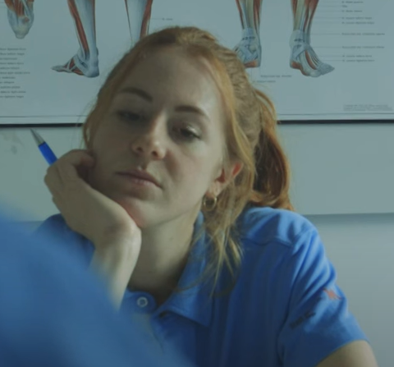
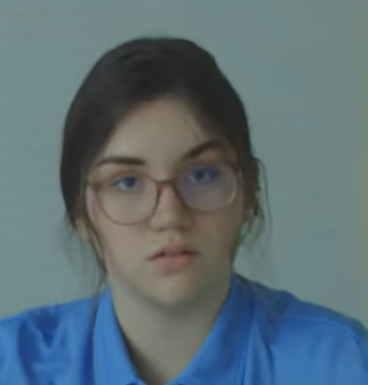
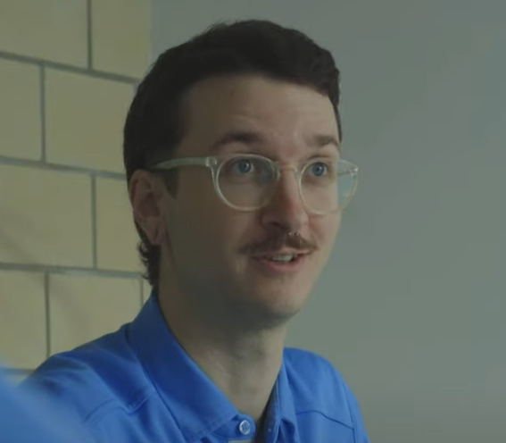
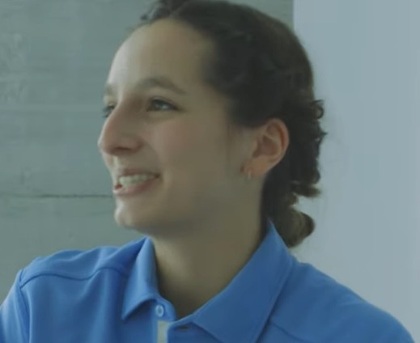
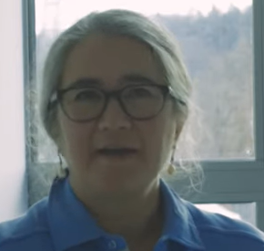
LOST IN COMMUNICATION
LOST IN COMMUNICATION
Elena
Amanda
Sam
Alina
Susan
Notes:
Facilitator notes: You can re-watch the video here before diving back into discussion if you would like. Ask participants to take notes on the instances of pacing and direct and indirect communication as they watch the video.

Slide 27
LOST IN COMMUNICATION
ZHAW Gesundheit. (2022, February 2). Lost in communication: an intercultural meeting [Video]. YouTube. https://www.youtube.com/watch?v=JfATJkWyd7g&t=17s
Notes:
Facilitator notes: You can re-watch the video here before diving back into discussion if you would like. Ask participants to take notes on the instances of pacing and direct and indirect communication as they watch the video.

Slide 28
LOST IN COMMUNICATION
LOST IN COMMUNICATION
Discuss the communication styles and patterns you observed in the video in your small groups.

Slide 29
LOST IN COMMUNICATION
LOST IN COMMUNICATION
Where does each character (Elena, Sam, Amanda, Alina, and Susan) from the video fall on the continuums we discussed (emotional restraint/expressiveness, indirectness/directness, patterns of communication pacing etc.)?
What are the met and unmet needs as well as frustrations of each character?
What mindset and attitude shifts might be helpful for each character as they engage with one another?
What behavioral shifts might be helpful for each character as they engage with one another?
What other strategies can you identify to ensure that the team functions well?

Slide 30
Role-play and apply

Slide 31
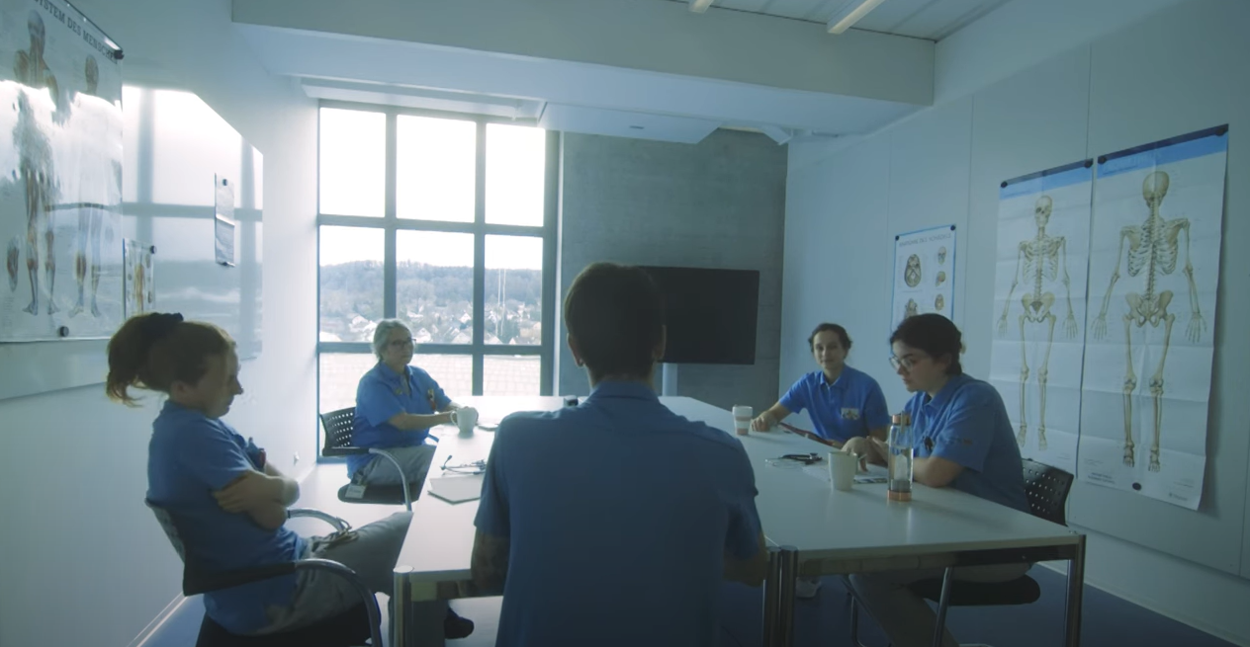
LOST IN COMMUNICATION
LOST IN COMMUNICATION
In groups of 5:
Assign each group member to play the role of a character from the video.
Reenact the conversations in your assigned role but modeling the mindset/attitude/behavioral shifts that help engage your character with others.

Slide 32
LOST IN COMMUNICATION
LOST IN COMMUNICATION
Elena
Amanda
Sam
Alina
Susan

Slide 33
debrief

Slide 34
LOST IN COMMUNICATION
How did it feel to role play this scenario? What did you notice? How easy/difficult was it to shift your communication style?
Did this activity bring up any real-world applications (either personal or general examples) for you?
Did this activity challenge your behavior or thinking in any way? How so?
How might you apply what you learned through this activity to a future team meeting? What do you want to remember when you encounter challenging team dynamics in the future? What strategies would you use when different pacing patterns occur in a group conversation?
What does an inclusive team look like?

